Slide 1
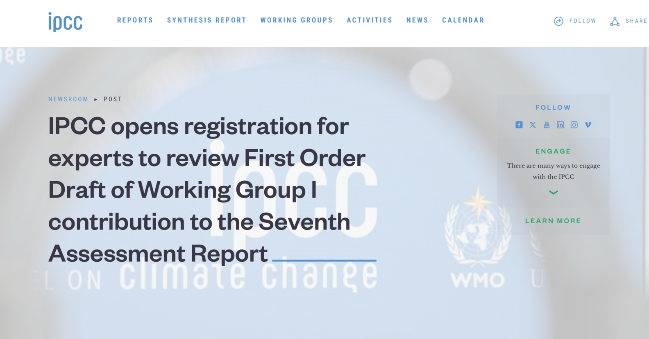
IPCC Expert Review

Slide 2
USAA-IPCC - who we are & what we do
Members:
Colby College
College of the Atlantic
Dickinson College
Emory University
Indiana University
Princeton University
Rutgers University
Washington University in St. Louis
Woods Hole Oceanographic Institute
Yale University
University of California, San Diego
U.S. academic institutions registered as observers with the IPCC.
Aim to increase awareness of authorship calls and facilitate nomination opportunities for experts in climate research and practice working in the United States
AGU, the world’s largest association of earth and space scientists, hosts the alliance.
Today’s webinar presenters
Jessy O’Reilly, Indiana University
Neil Leary, Dickinson College,
Michael Oppenheimer, Princeton University
Beth Martin, Washington University in St. Louis

Slide 3
AR7 Expert Review
Working Group I – The Physical Science Basis
Review period – First Order Draft (FOD): August 10 - October 2
Register to review by: September 25
https://www.ipcc.ch/2026/07/06/ipcc-wg1ar7-expert-review/
Special Report on Methodologies for Short Lived Climate Forcers
Review period - Second Order Draft (SOD): August 31 - October 25
Register to review by: October 18
https://www.ipcc.ch/2026/08/13/prslcfsod/
Working Group II – Impacts, Adaptation and Vulnerability
FOD to be released for review after the 3rd Lead Authors’ Meeting (early November 2026)
Working Group III - Mitigation of Climate Change
Schedule to be decided

Slide 4
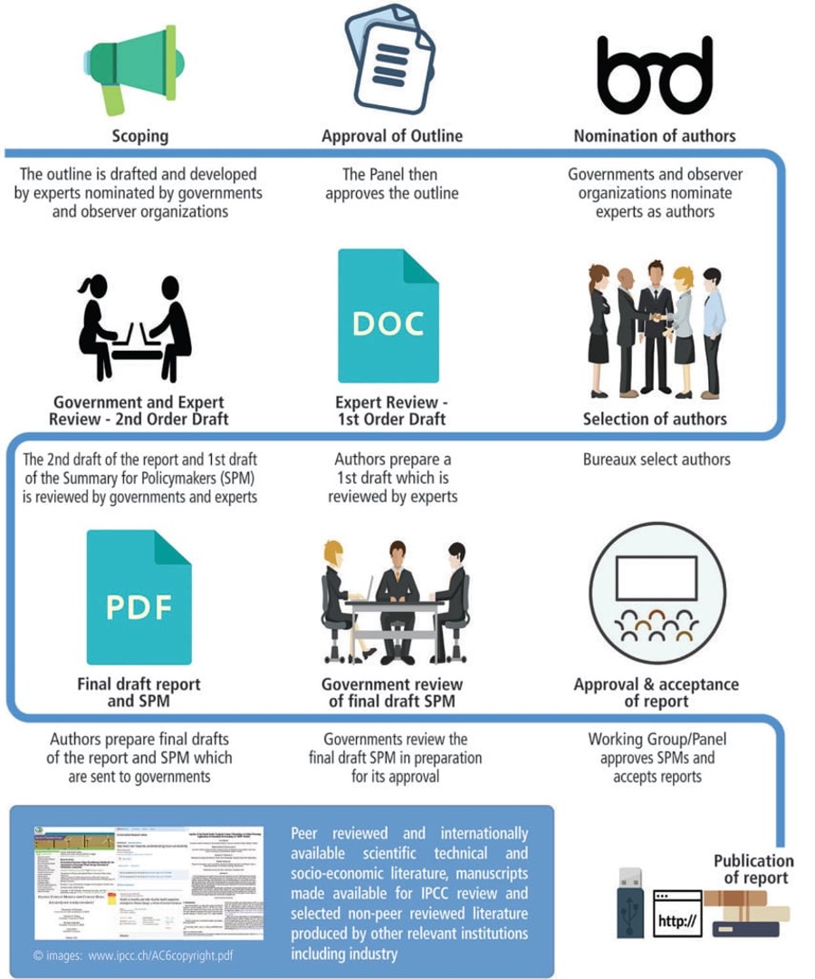
IPCC Report Development Process
“Approval” - material has been subjected to detailed line-by-line discussion and agreement. This is the procedure used for the Summary for Policymakers.
“Adoption” - a section-by-section endorsement. This is used for the Synthesis Report and overview chapters of Methodology Reports.
“Acceptance” signifies that the material has not been subject to line-by-line or section-by-section agreement but nevertheless presents a comprehensive, objective and balanced assessment of the subject matter.

Slide 5
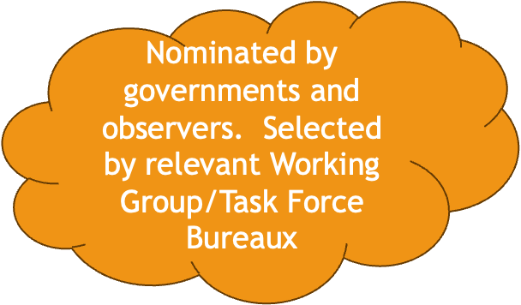
IPCC Authors and Roles
•Coordinating Lead Author
•overall responsibility for coordinating major sections of a Report.
•Ensuring compliance to high standard
•Ensure crosscutting and technical issues are addressed completely and coherently
•Lead Author
•responsible for the production of designated sections on the basis of the best scientific, technical and socio-economic information available
•Review Editor
•assist the Working Group/Task Force Bureaux in identifying reviewers for the expert review process, ensure that all substantive expert and government review comments are afforded appropriate consideration, advise lead authors on how to handle contentious/controversial issues and ensure genuine controversies are reflected adequately in the text of the Report.
•Contributing Author
•prepare technical information in the form of text, graphs or data for assimilation by the Lead Authors into the draft section.
•Expert Reviewer
•comment on the accuracy and completeness of the scientific technical/socio-economic content and the overall scientific/technical socio-economic balance of the drafts.

Slide 6
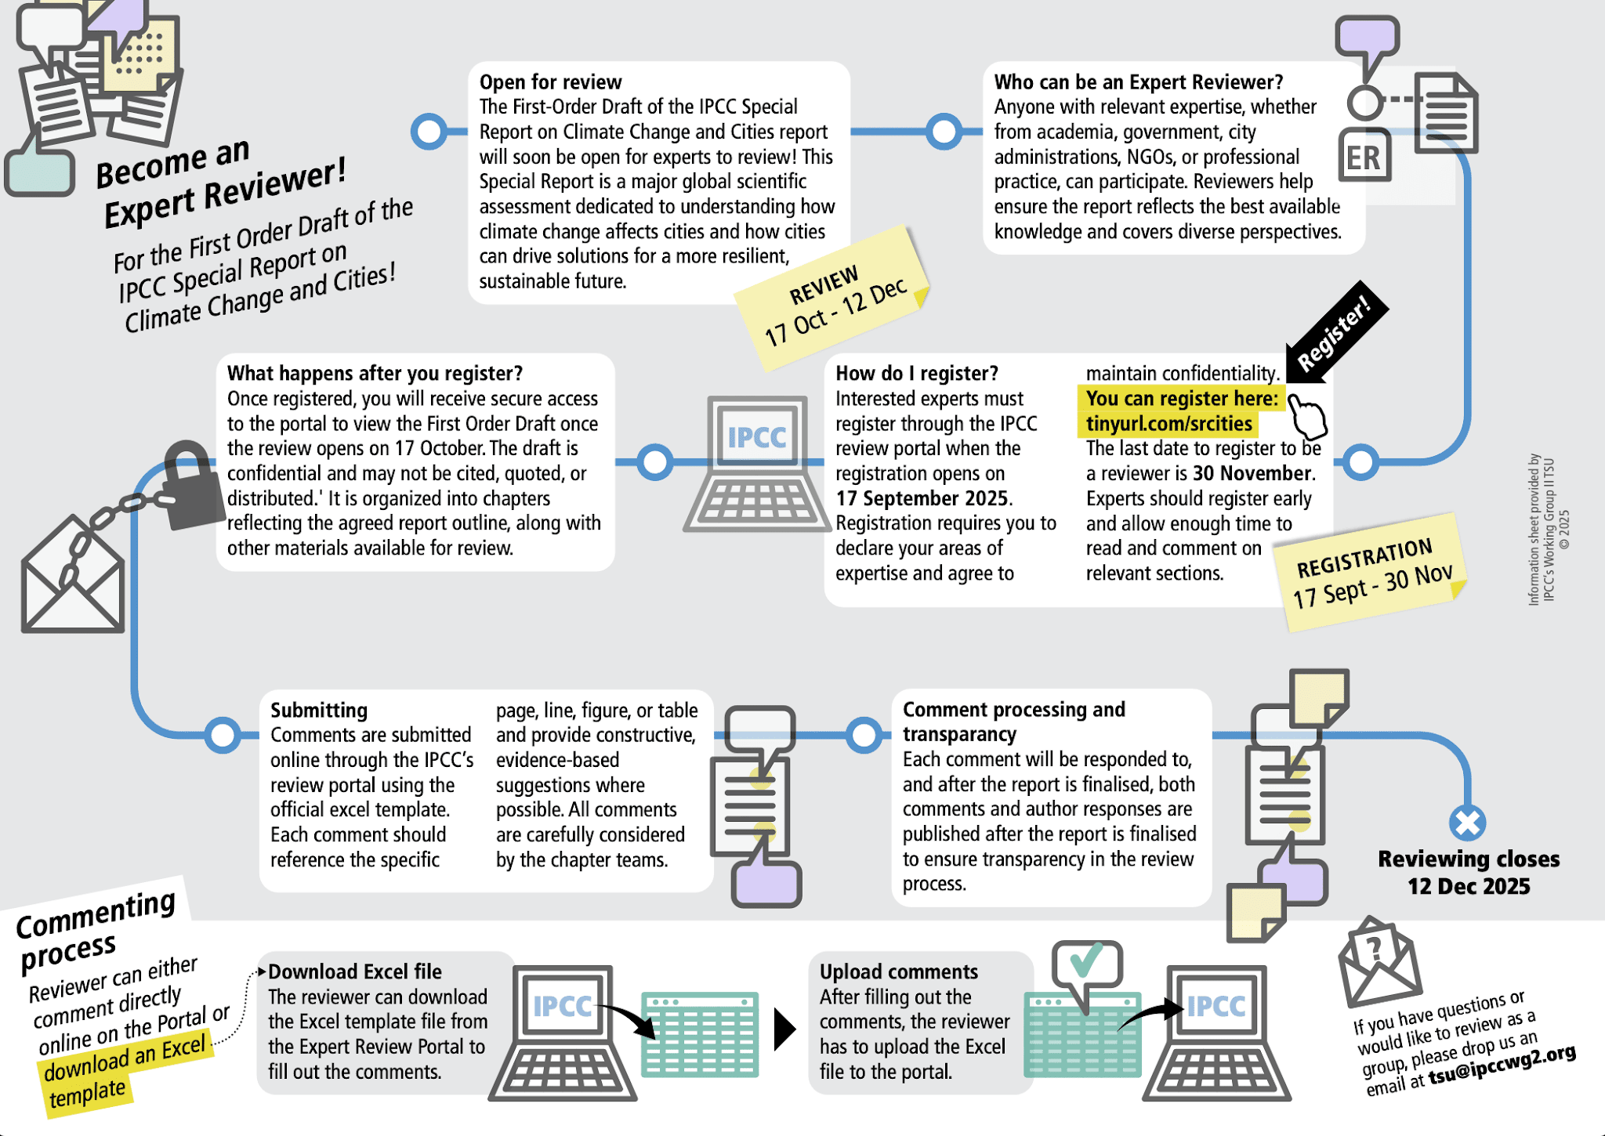
Thi
This graphic was created for the Special Report on Climate Change and Cities – but the process is the same for the First Order Draft Review for all the WG reports. Just ignore the dates!
Notes:
Taken from WG 2 newsletter

Slide 7
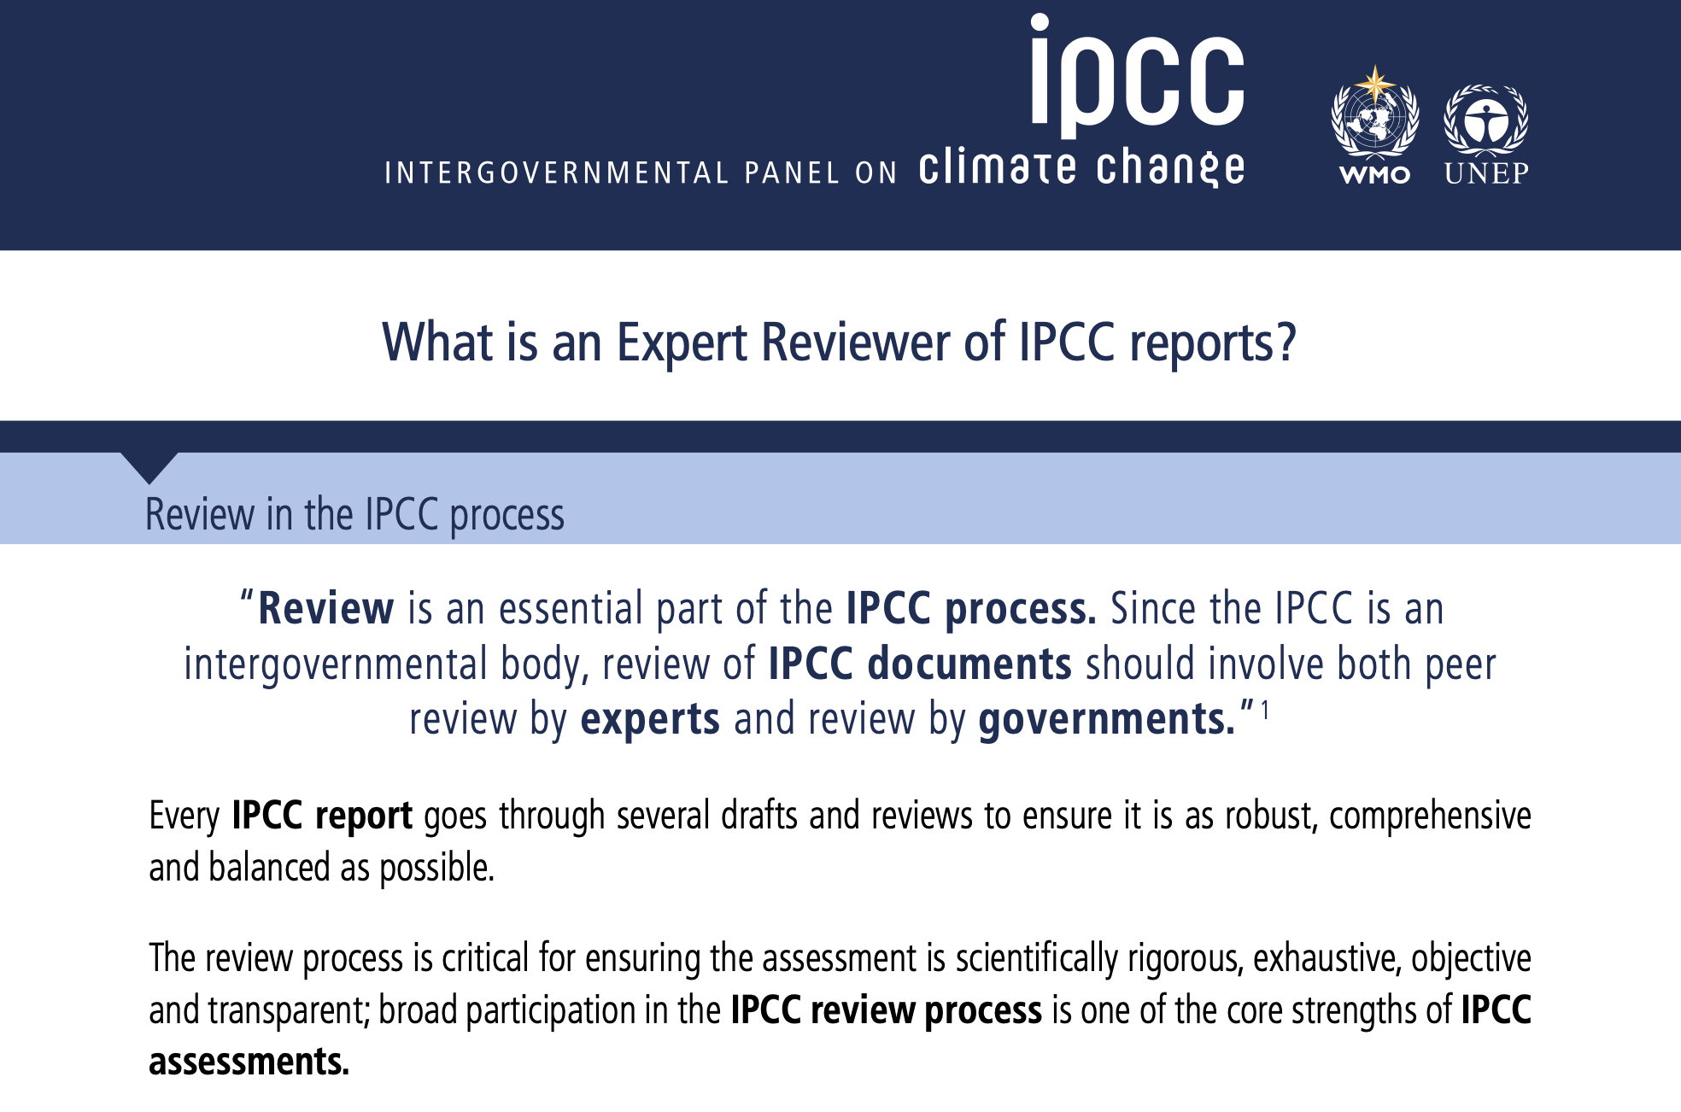
What is IPCC Expert Review?
Notes:
https://www.ipcc.ch/site/assets/uploads/2020/12/WhatisanExpertReviewer.pdf

Slide 8
Role of expert review?
Who?
  Experts are self nominated or may also be invited to register
  If you have relevant expertise and qualifications, you can register to be an expert reviewer.
What?
  Experts can comment on the part of the report they have expertise on. It can be one sentence, one section or a chapter of the report.
  Can comment on scientific substance or structure of the report.
  Can reference publications that might not have been included.
Notes:
https://www.ipcc.ch/2020/12/04/what-is-an-expert-reviewer-of-ipcc-reports/

Slide 9

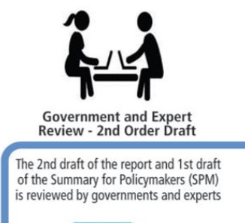
Expert Review and Government Review
First Order Draft
Expert review only
Second Order Draft
Experts & Governments conduct review

Slide 10
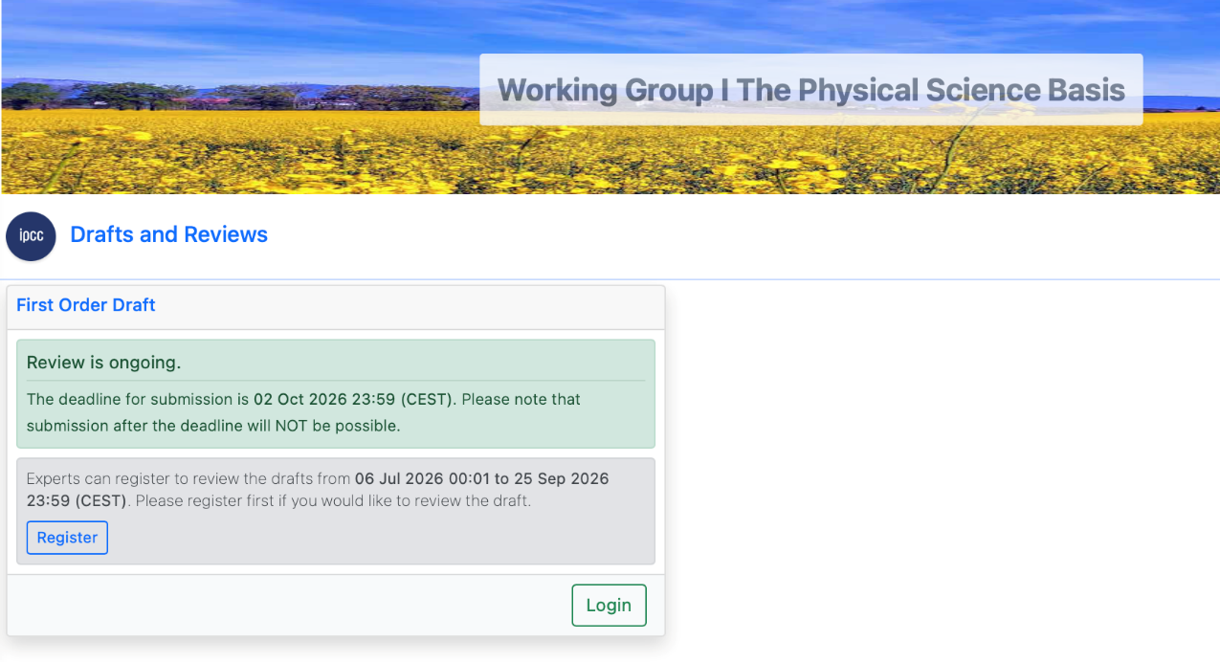
How to sign up as an Expert Reviewer?
For Working Group1 (the review that is currently open):
Go to https://apps.ipcc.ch/comments/ar7wg1/register.php?q=fod BEFORE 25 September.
Reviews will be due before 2 October

Slide 11
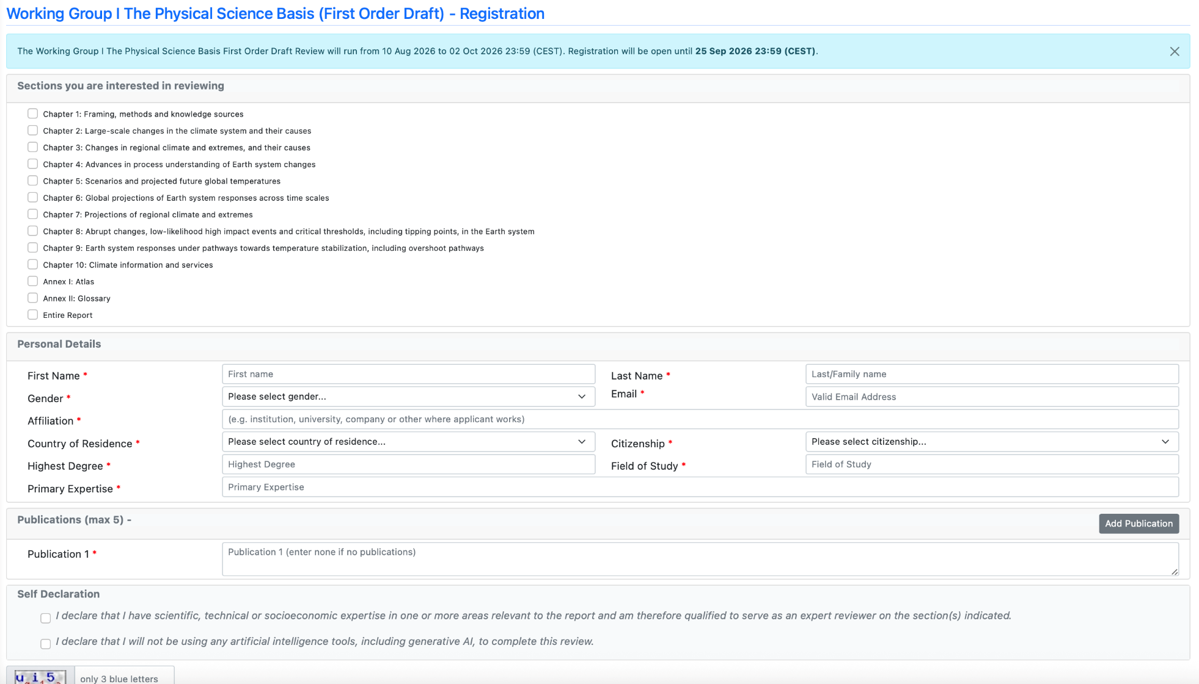

Slide 12
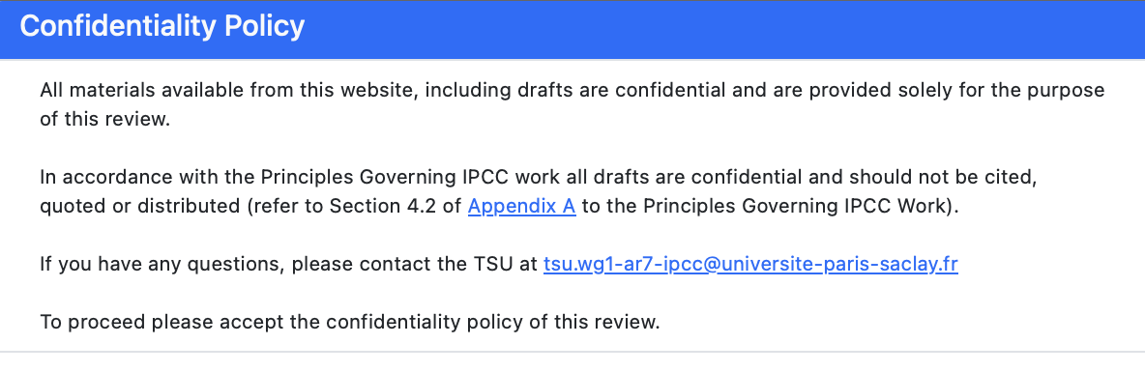

Slide 13
Information from IPCC
All drafts and review materials are confidential and provided solely for the purpose of this review. They may not be cited, quoted or distributed. Reviewers may not reproduce the contents of the First Order Draft, including in social media and other public fora. The final version of the report will become publicly available following its approval and acceptance by the IPCC.
Each draft for review includes page and line numbers to be used when preparing your review. You may provide overarching comments on the entire report or its individual components, or you may provide specific comments by page and line number. Please note that the final report will undergo a formal copyedit prior to publication. Your review comments will be most useful if they focus on substantive issues rather than minor editorial changes.
Please note that all comments must be submitted in English, using the Review Portal prior the close of the review period. Only comments submitted through the review portal will be considered by the authors. For the government and expert reviews, which is a formal component of the report development process, the drafts submitted for review, the review comments, and the subsequent responses by the authors will become publicly available once the report is published. Following IPCC practice, review comments are not anonymous.
Artificial intelligence (AI) tools, including generative AI tools, may not be used to complete this review. On agreeing to the confidentiality policy of the review and to the non-use of AI tools, you will then be able to access the drafts. A personal copy was attributed to you when your registration was accepted.

Slide 14
How to provide expert review?
Register in advance and get access to the confidential PDFs of report
Give yourself enough time to thoroughly read the sections of the report you are commenting on
Aim your comments at substantive topics, not editorial ones
If you do not have expertise, do not feel you need to make a comment on all sections
Be positive and considerate in your comments, even if you are being critical
Comments that support existing material are welcome as well
Suggesting additional references is useful, just make sure they are not only yours
Use the correct format for submitting your comments
  use one of the three commenting options available in the system
  instructions for use are included in tab “instructions” of the portal and a downloadable User Guide is available in tab 'Extra'
Must be submitted by the deadline, through the portal, otherwise will not be considered

Slide 15
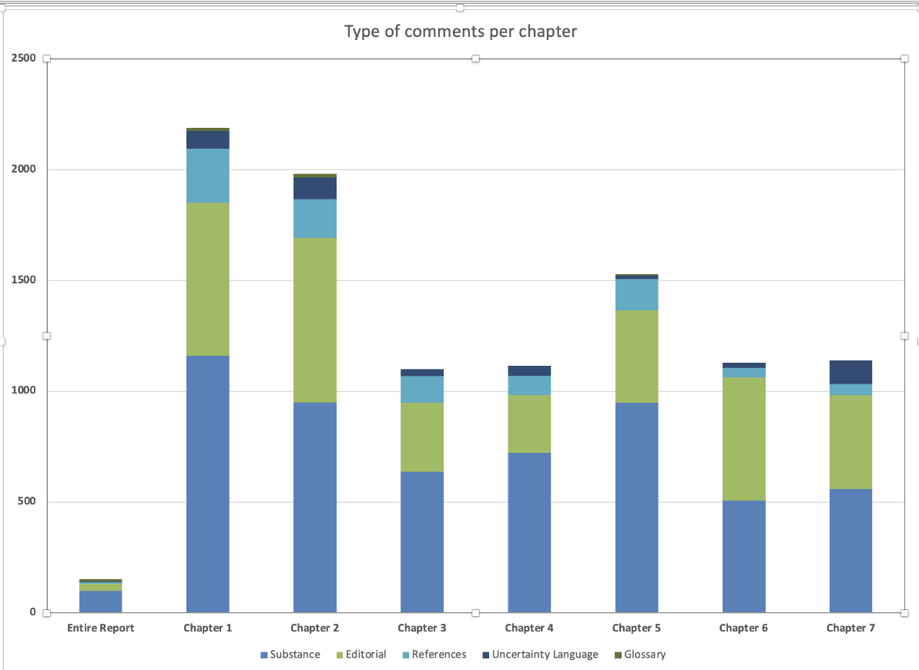
What is an effective review?
Comments received on FOD of SR on CC and Land, 2018

Slide 16
Expert Review and Government Review
First Order Draft
Expert review only
Second Order Draft
Experts & Governments conduct review

Slide 17
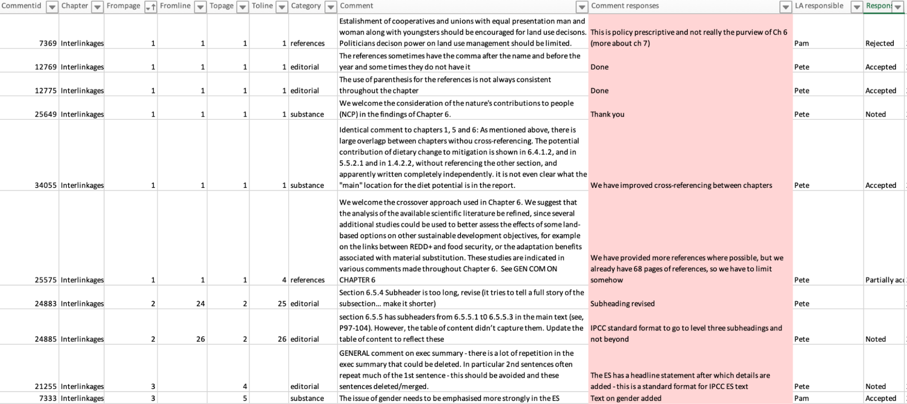
How is expert review used by author teams?

Slide 18
Questions?
Contact information:
pamela.mcelwee@rutgers.edu
jloreill@iu.edu
martin@wustl.edu
learyn@dickinson.edu
omichael@princeton.edu
usaa-ipcc@gmail.com
rrazaak@agu.edu

